Slide 1

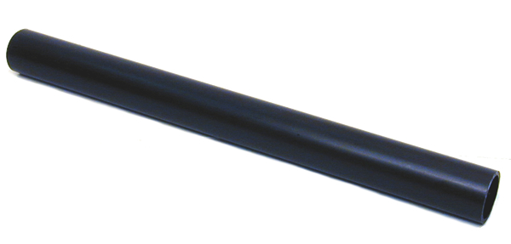
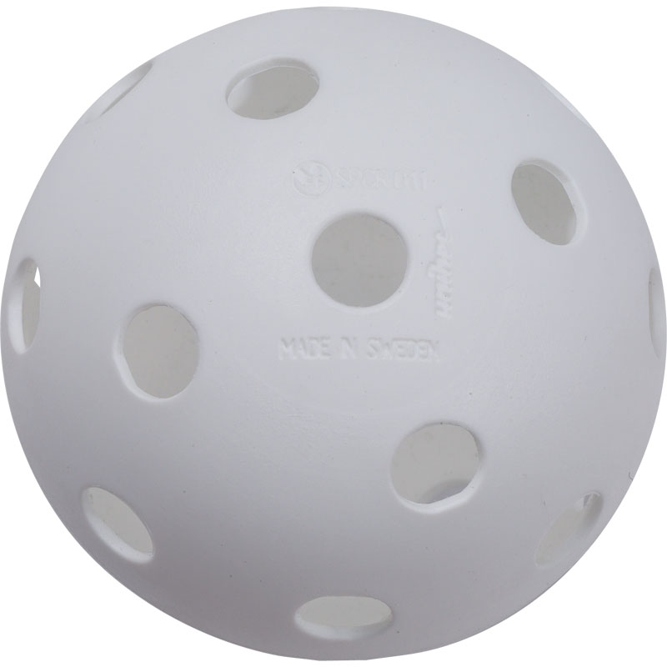
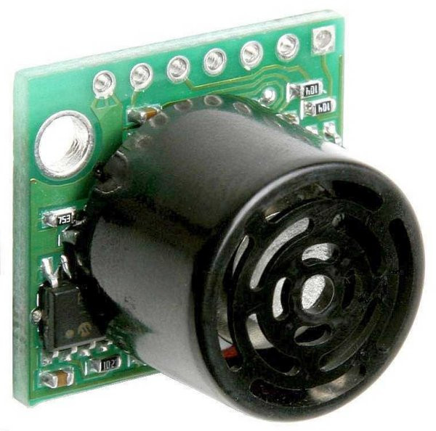
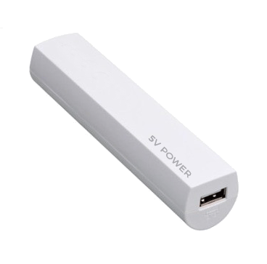
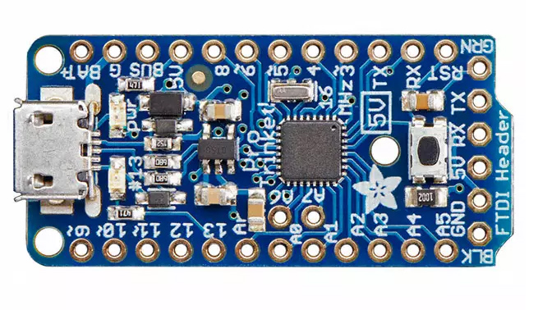
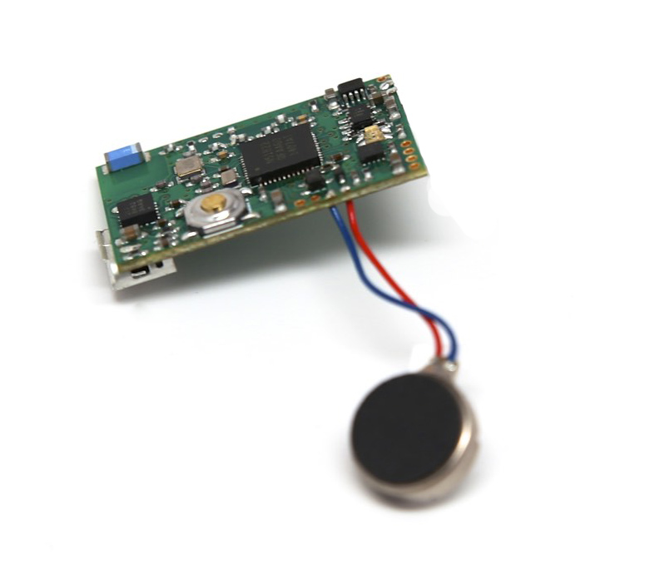
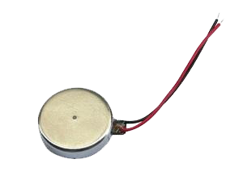

team echo – product schematic
NOTE: the enclosure should ideally be printed in 3D to accommodate
the components tightly and add branding, but due to the time constraints at the
Telstra hackathon we had to provide some temporary housing instead
_{Perforated}
_{Ball}
_{Final look and feel}
_{PCV Pipe}
_{Enclosure}
_{Ultrasonic Range}
_{Finder}
_{USB Power Supply}
_{5V 16MHz}
Adafruit ‘Trinket’ Microcontroller (Arduino Compatible)
_{2x Coin}
_{Vibration Motors}
Echo Assistive Technology – Entry to the Telstra “Construct Now” Hackathon in Melbourne Exhibition St, 15-17 April 2016.
By Jonas Olausson, Keaton Okkonen, Jacob Aharon and Steven de Salas

